Slide 1




Javascript Technology
The AngularJS MVW Framework
Pezhman Nasirifard — Max Zitzmann
Technische Universit¨at Mu¨nchen
April 29, 2015

Slide 2


Live Demo
We Implemented a single-page real-time chat room app based on pure AngularJS.
Before we begin let’s have a live demo!
Participate by going here: http://angularchat.atwebpages.com/

Slide 3

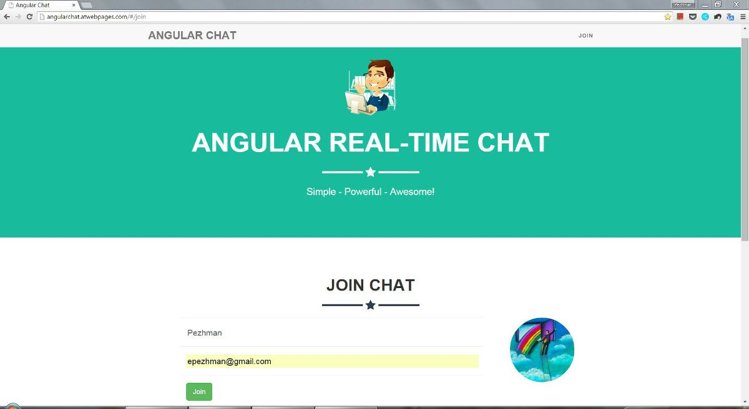
Live Demo
On Your Laptop . . .

Slide 4
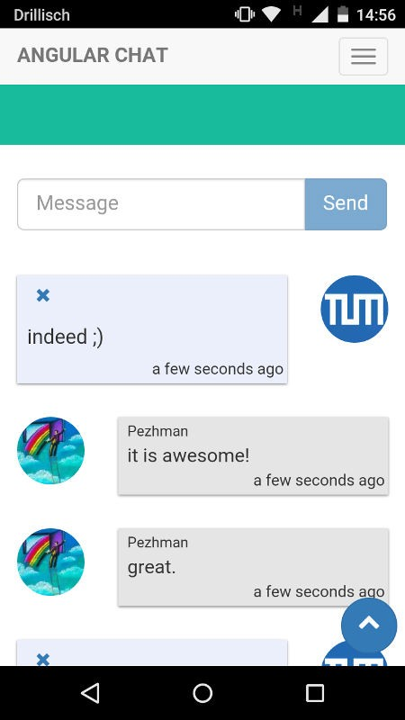
Live Demo
. . . OR Your Smart Phone

Slide 5


Agenda
Introduction Controllers and Models Directives and Views Services
Routing Modules Clean Code Testing Conclusion

Slide 6
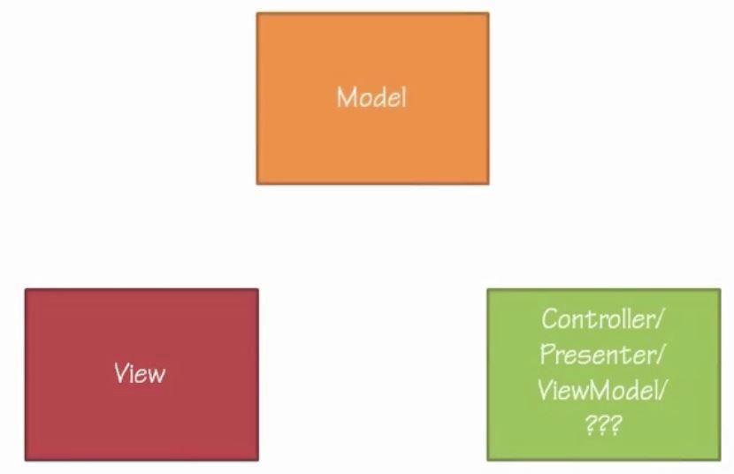
Introduction
What is Angular?
◮ A Model-View-Whatever JavaScript Framework.

Slide 7
Introduction
What is Angular? (contd.)
◮ Open source project made by Google.
◮ Angular is comprehensive.
◮ Angular made to be Testable, supports Unit Test and End-To-End Test.
◮ Extends HTML by creating new tags.
◮ Angular is the future of the web!

Slide 8
Introduction
Angular Architecture
◮ Two Way Bindings
◮ Dirty checking
◮ Dependency Injection

Slide 9
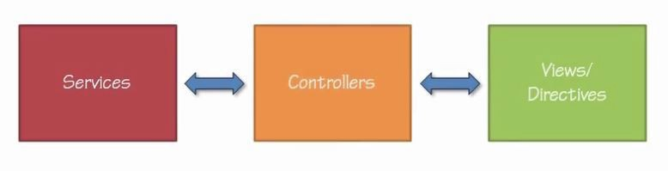
Introduction
Angular Components
◮ Controllers
◮ Views/Directives
◮ Services

Slide 10
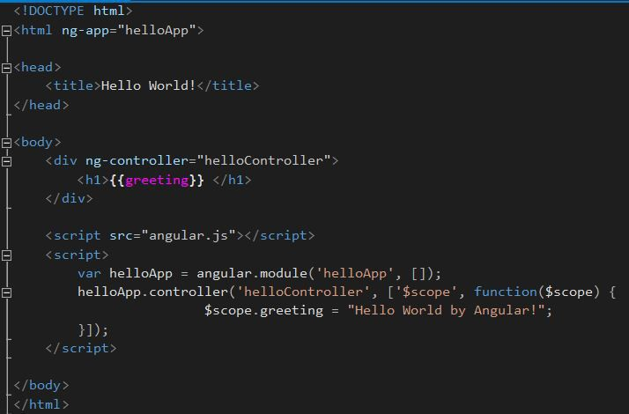
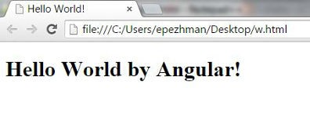
Introduction
A simple Hello World app with Angular
◮ Only 2 requirements: angular.js file and ”ng-app” directive.

Slide 11
Controllers and Models
Controllers and Models
◮ Controllers and Scope
◮ Models
◮ Two Way Binding

Slide 12
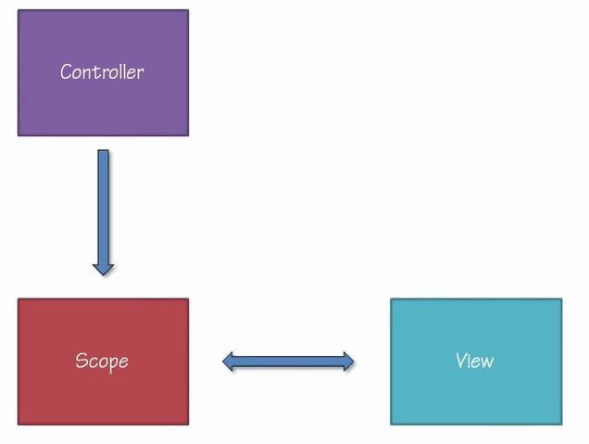
Controllers and Models
Controllers and Scope
◮ Controller’s primary responsibility is creating Scope.
◮ Scope passes and binds the data and the methods back and forth between controllers and views.
◮ Scope is not the Model.
◮ Controllers can get attached to DOM elements via ”ng-controller” directive.

Slide 13
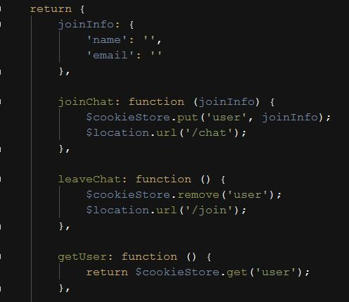
Controllers and Models
Models
◮ Models are basic JavaScript objects with fields and methods, nothing fancy here!
Figure: Part of our user model for joining the chat

Slide 14
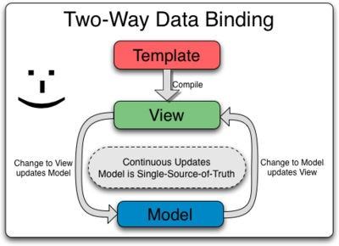
Controllers and Models
Two Way Binding
◮ Personally we think it’s the coolest feature of Angular!
◮ It is the automatic synchronization of data between the model and view. components
◮ When the model changes, the view reflects the change, and vice versa.

Slide 15
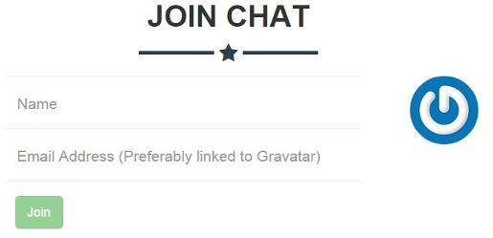
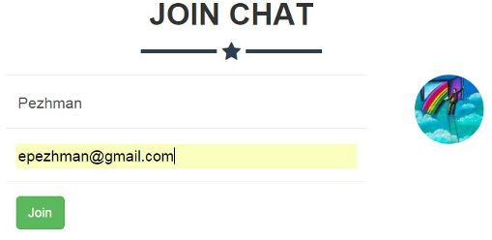
Controllers and Models
Two Way Binding - An Example
◮ At Join page, the picture gets updated as soon as user enters an email linking to Gravatar.
Figure: Join form
Figure: Join form after entering email

Slide 16
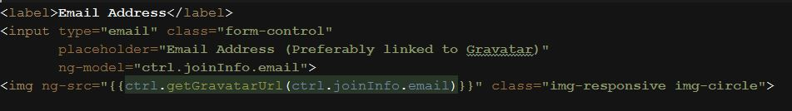
Controllers and Models
Two Way Binding - An Example (contd.)
◮ This revolves around ”ng-model” directive.
◮ ”ng-model” directive can be set on input, select and textarea elements.
Figure: Join chat HTML page, linking email and image tags

Slide 17
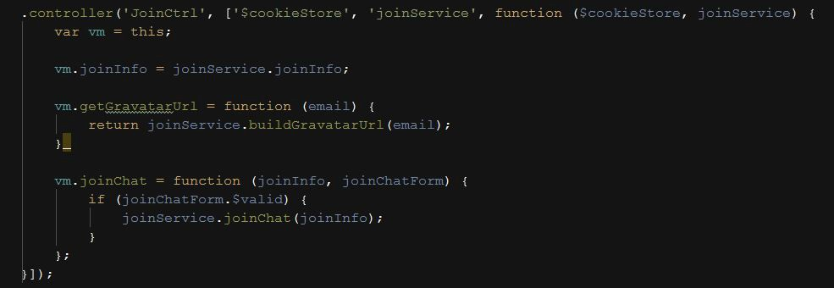
Controllers and Models
Two Way Binding - An Example (contd.)
◮ All this is done automatically by Angular, there is no listener set directly on controller.
Figure: Join chat controller

Slide 18
Directives and Views
Directives and Views
◮ Directives
⋆ Built-in directives
⋆ Event directives
⋆ Custom directives
◮ Markups
◮ Filters
◮ Forms and Validation

Slide 19
Directives and Views
Directives
◮ An attribute or element that improves an existing DOM element or represents a reusable DOM component.
◮ They add new functionality to existing HTML.
◮ They can add new HTML Components.
◮ They can be used to manipulate DOM element from within controllers.

Slide 20
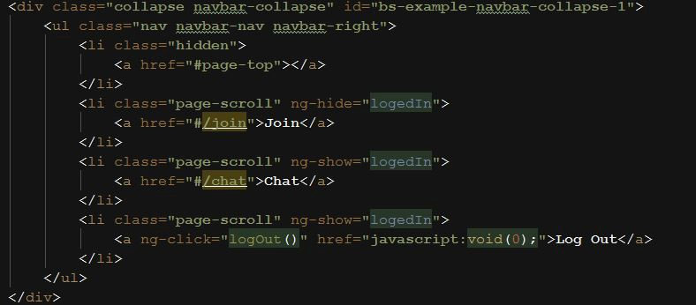
Directives and Views
Built-in Directives
◮ Angular comes with many built-in directives.
◮ We also benefited from many of these directives like ”ngShow”, ”ngHide”, ”ngDisabled”, ”ngController”, ”ngSrc” and etc.
Figure: ”ngShow” and ”ngHide” directives show and hide links based on model

Slide 21
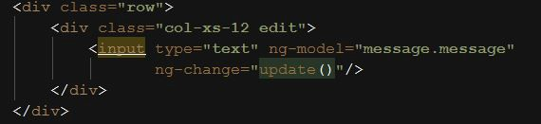
Directives and Views
Event Directives
◮ Event directives are part of built-in directives
◮ They listen to events on DOM elements and fire Controller methods accordingly
◮ We benefited from many of these event directives such as ”ngSubmit”, ”ngChange”, ”ngClick” and etc.
Figure: ”ngChange” directive calls the update() method on controller when user changes the input

Slide 22
Directives and Views
Custom Directives
◮ Custom elements and custom events can be made by directives.
◮ By custom elements new domain specific web components can be added to the HTML.

Slide 23
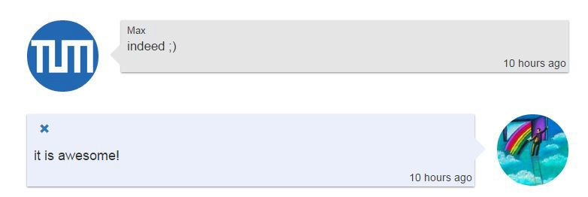
Directives and Views
Custom Directives - An Example
◮ We created custom directives for displaying chat messages.
Figure: Thread of messages

Slide 24
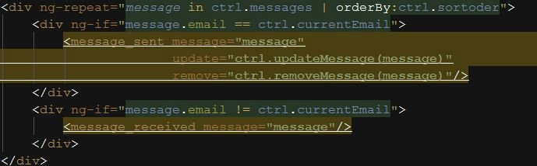
Directives and Views
Custom Directives - An Example (contd.)
◮ Messages are made by these 2 new HTML tags.
◮ Each new tag is a custom directive which data can be passed to.
◮ Behind each directive there is a JavaScript config file and a HTML template file which creates the content of the new elements.
Figure: Thread of messages

Slide 25
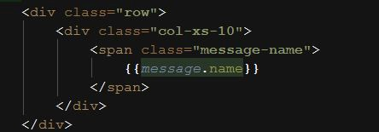
Directives and Views
Markups
◮ The double curly brace notation {{ }} to bind expressions to elements is built-in Angular markup.
Figure: Displaying user’s name linked to the model

Slide 26
Directives and Views
Filters
◮ They modify and format data for display.
◮ They do 3 main things:
⋆ Formatting - e.g. making string uppercase.
⋆ Sorting Datasets.
⋆ Filtering Datasets.
Figure: orderBy filter used to sort messages based on create date

Slide 27
Directives and Views
Filters (contd.)
◮ Angular comes with many built-in filters.
◮ Multiple filters can be applied on one single data.
◮ Filters can get extended by creating custom filters.
Figure: 2 filters was applied on create date, ”date” is a built-in filter for formatting date and ”timeAgo” is a custom filter showing how recent message is

Slide 28
Directives and Views
Forms and Validation
◮ Angular supports form validations and posts the form to the server only when valid.
◮ Validation can get extended by creating custom validation.
Figure: Part of join form. email field should be filled and ”ngPattern” directive is used to checks input toward Regex pattern

Slide 29
Services
Services
◮ What is a Service?
◮ Built-in Services
◮ Custom Services

Slide 30
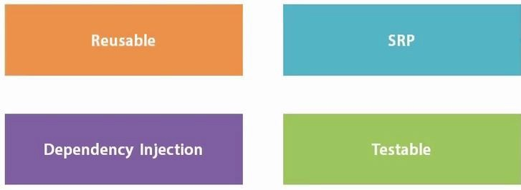
Services
What is a Service?
◮ Angular services are substitutable objects that are wired together using dependency injection (DI).
◮ Services can be used to organize and share code across the app.
◮ Angular services are:
⋆ Lazily instantiated
⋆ Singletons

Slide 31
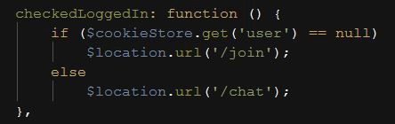
Services
Built-in Services
◮ Angular comes with many built-in services.
◮ These services can get injected into controllers, filters and other services.
◮ We used many built-in services such as ”$location”, ”$cookieStore”, ”$anchorScroll” and etc.
Figure: ”$location” and ”$cookieStore” are used to check if user is logged in and redirect him accordingly

Slide 32
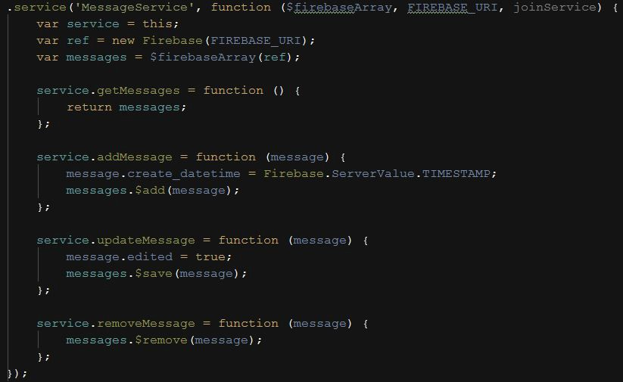
Services
Custom Services
◮ We created 2 custom services:
⋆ One for handling and sharing user model across controllers.
⋆ The second for handling chat communications with server.
Figure: Message Service handles communication with server by using Firebase service

Slide 33
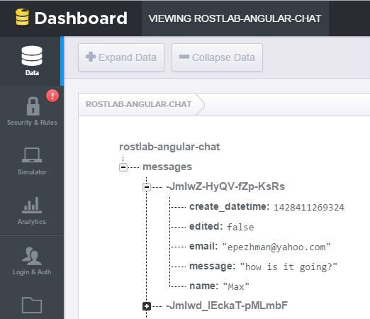
Services
Custom Services (contd.)
◮ Firebase is a powerful API to store and sync data in real-time.
◮ Firebase offers a great Angular service which makes it more convenient to communicate with Firebase servers.
◮ By using Firebase real-time service there is 3 way binding between Server, Controller and the View!
Figure: Stored data on Firebase servers

Slide 34
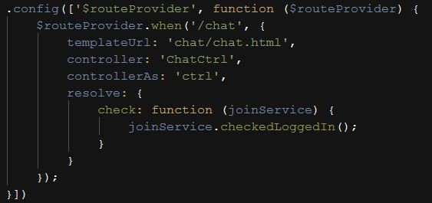
Routing
Routing
◮ Routing is the key part of creating Single-page applications.
◮ By routing app navigates though pages via AJAX without reloading the whole page.
◮ By routing app can pass data from one view to other controller.
Figure: Routing for chat page

Slide 35
Modules
Modules
◮ Module is a container for the different parts of the app controllers, services, filters, directives, etc.
◮ Modules declaratively specify how an application should be bootstrapped
◮ There are several advantages to this approach:
⋆ The declarative process is easier to understand.
⋆ You can package code as reusable modules.
⋆ The modules can be loaded in any order (or even in parallel) because modules delay execution.
⋆ Unit tests only have to load relevant modules, which keeps them fast.
⋆ End-to-end tests can use modules to override configuration.

Slide 36
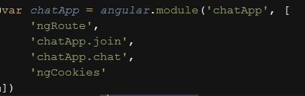
Modules
Modules (contd.)
◮ Our app consists of 3 custom modules and a few built-modules.
Figure: Chat module
Figure: Join module
Figure: Main app module which integrates all modules together

Slide 37
Clean Code
Clean Code
◮ JavaScript projects can get very huge. To maintain readability and scalability, following a proper pattern for the coding and the structure of projects is trivial.
◮ We used Separation of Concerns pattern for organizing our code.
◮ We used Angular-Seed as a base for our project - it’s a good structure for small projects.

Slide 38


Clean Code
Clean Code (contd.)
◮ There are many different Angular Controller pattern and Dependency Management methods out there. We implemented a few for the purpose of comparison.
◮ It’s important to choose the pattern works best for you and be consistent with it.
Figure: Different Controller patterns and dependency injections

Slide 39
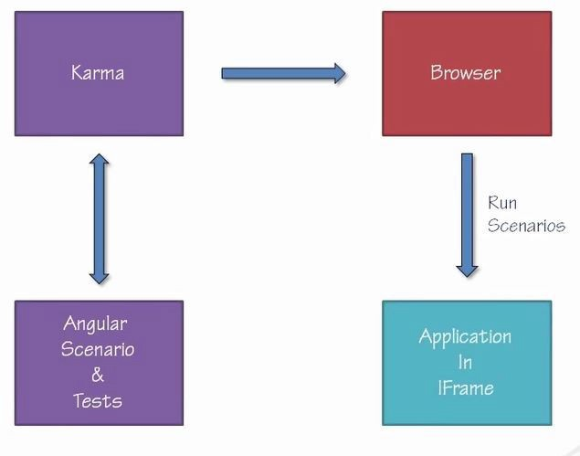
Testing
Testing
◮ Angular is written to be testable.
◮ Karma is a preferable tool to test Angular.
◮ Karma supports Unit Testing and a great End-To-End Testing on Angular.
Figure: Karma running End-To-End Test

Slide 40
Conclusion
Conclusion
◮ We just showed the tip of the iceberg, there are much more details and many more interesting features.
◮ The AngularJS official website is a great place to start learning: https://docs.angularjs.org/
◮ Angular is a complete client-side solution which is opinionated about how a CRUD (Create, Read, Update, Delete) application should be built.
◮ Angular and its mentality is the future of the web, so if you are dealing with JavaScript in your career, sooner or later, you will end up learning such a framework.
◮ Finally we think Angular is the coolest thing happened to client side JavaScript since jQuery!

Slide 41
Thank You
Questions?

